Slide 1
Teaching to Students to Self-Reflect before/after Assessments
An easy strategy that can be applied to any classroom without changing your day to day teaching.

Slide 2
Simple, clear learning targets for students are essential.
Each learning target has a “concept check”
These concept checks occur daily
The same target exists on the test.
When the student receives the test back they must compare their concept check score with their unit test target score.
If the test score is higher the grade for the quiz gets bumped up.
Most teachers are already doing this in their classrooms.

Slide 3
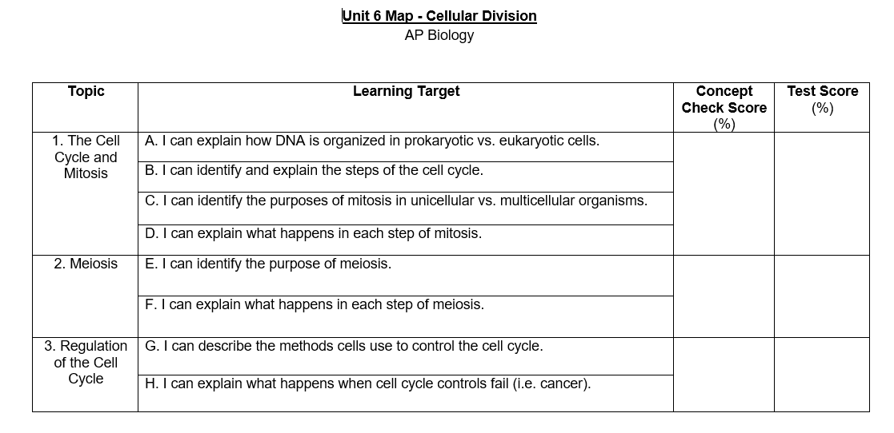

Slide 4
Students using the learning targets as study
Guides can be a
Students re-evaluate scores on their prior concept checks.
Students must address their comfort level for each learning target.
Students must also site where this information was accessed throughout the unit.
If the student scored below a 70% on the concept check they must show evidence of understanding in their “reflection log”
http://burdabiology.weebly.com/evolution.html

Slide 5
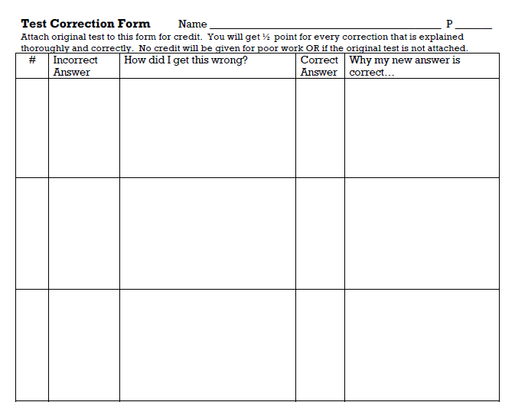
When you give the test back what are the students going to do with that information?

Slide 6
I usually assign the “test corrections” form as a classwork grade.
Any student may retake any learning target on the test but they must complete a target practice in addition to the test corrections form.

Slide 7
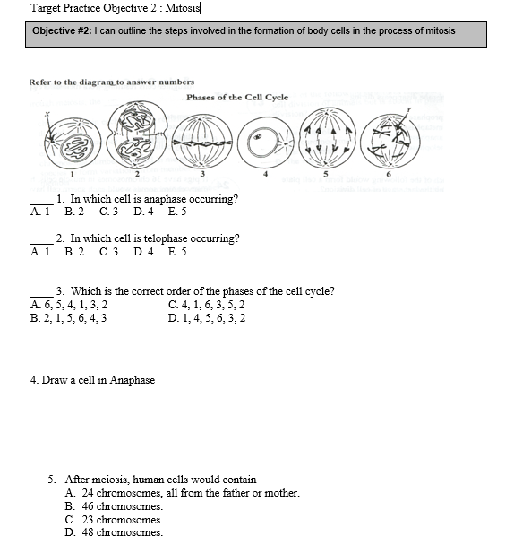
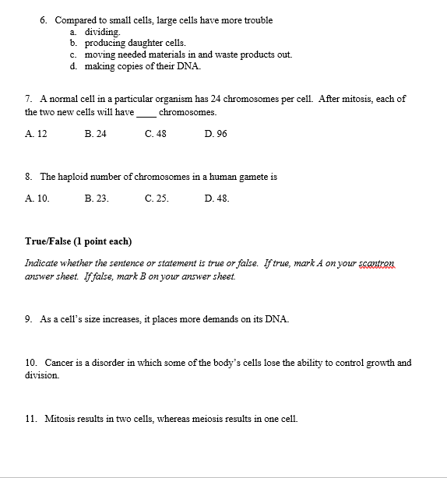

Slide 8
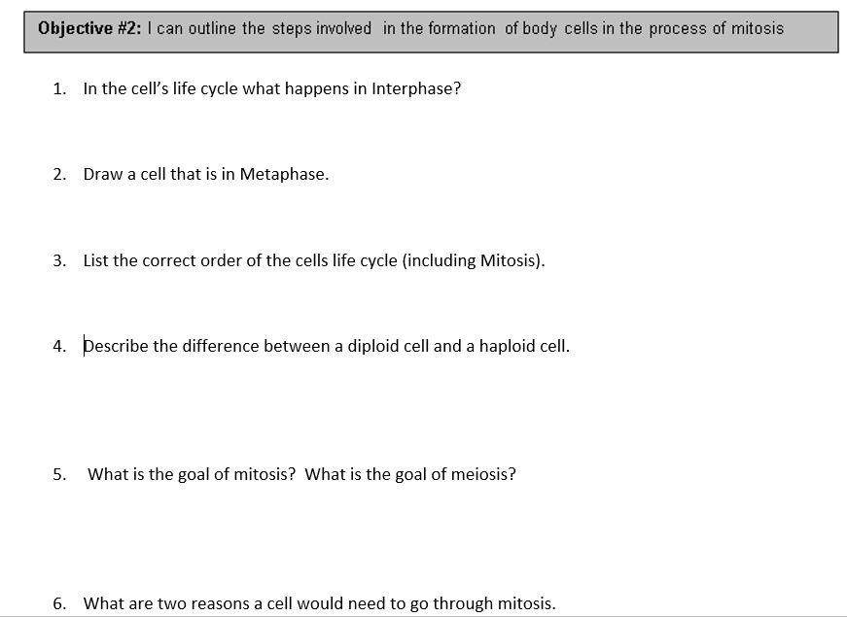
Sample Retake for Unit 5 Objective 2

